Slide 1

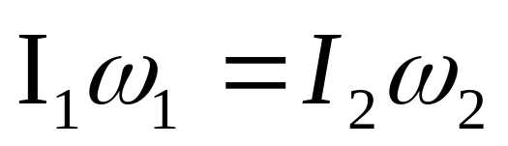
Rotational dynamics and Elasticity
Physics 131
Lecture 15
Today:
Angular momentum L=Iω
Conservation of angular momentum L
All found in Young and Freedman, University Physics, chapter 10 section 2, 5 and 6
Notes:
Today we’re going to look at some more analogies between linear and rotational mechanics. We’ll learn about
Rotational analogue of Newton’s second law
Relationship between torque and angular acceleration
Rotational analogue of linear momentum – angular momentum
Relationship between angular momentum, moment of inertia and angular velocity
Relationship between torque and angular momentum
Conservation of angular momentum
Here’s a list of what you need to know from this lecture. You have this information on the handout I have given you. The handout also includes the text book references.
I’ve kept it fairly simple but Feel free to stretch yourself when reading the text book.

Slide 2

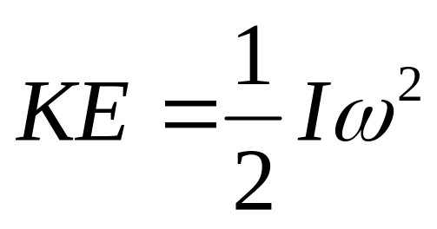
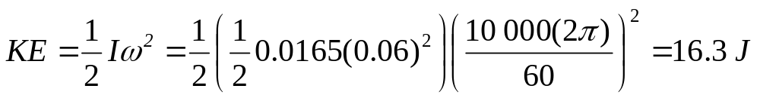
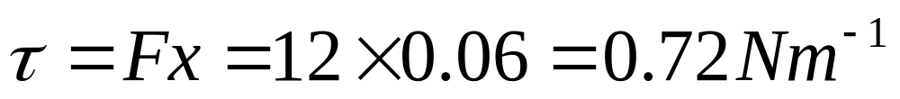
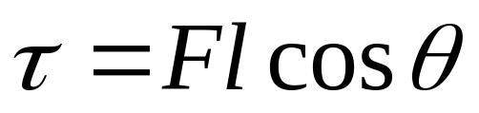
Review
How much KE does a spinning DVD have if it spins at 52x? The disc weighs16.5 g with a radius of 6 cm, and at 52x it spins at 10 000 rpm.
If a force of 10 N is applied to the edge of the DVD speeding it up. What torque has been applied?
Solid Disk I = 1/2mR²
Notes:
Last lecture we moved onto the study of rotational mechanics. First we went over some things that we learnt in Mech I wrt rotational motion…things like angular displacement, velocity and acceleration of extended objects. Then we studied kinetic energy in rotational motion (=1/2 I omega squared), a quantity called moment of inertia (I=sum of the mrsquared) and another called torque (force time perpendicular distance to axis of rotation).
See that these are rotational analogues to linear situations eg K = ½ I omega squared and K = ½ m v squared. Also see that for equilibrium sum of the forces = 0, sum of the torques = 0, where define F to right as =ve say and F to left –ve, clockwise torque +ve, anticlockwise –ve.

Slide 3
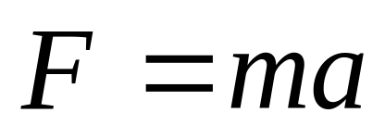
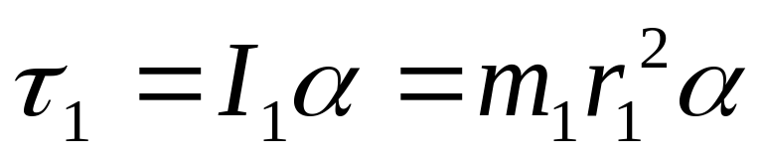
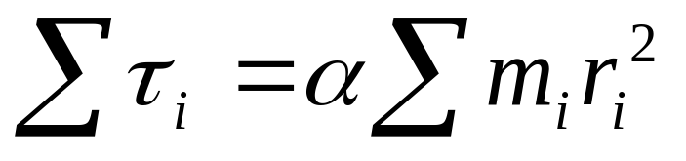
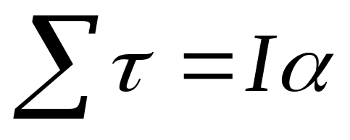
Newton’s second law in rotational terms
For linear case
Rotational analogy for each particle
Sum up for whole body
Notes:
Let’s begin by seeing the rotational analogue of Newton’s second law. In Newton’s 2nd law we have F = ma. So force = mass times acceleration.
In the rotational case we have a Force type quantity (torque ) and a mass type quantity (moment of inertia). We can relate the two by looking at the linear analogy F=ma.
For the rotational case we have
Torque (force quantity) = I(mass quantity) times alpha (remember that alpha was the rotational or angular acceleration). This is for each individual particle in the body (as remember that I = sum of the mrsquared and each part of the body has different r…alpha same) so we need to add these up to get the total torque. SEE EQUATIONS
So the sum of all the torques = I alpha, just like the sum of all the forces = ma. So this is a rotational analogue of Newton’s second law for a rigid body. A force thing = a mass thing times an accn thing.

Slide 4
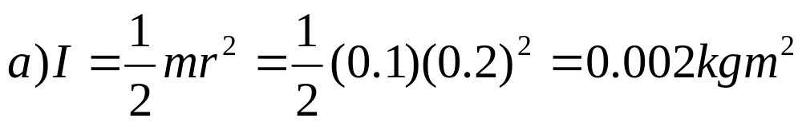
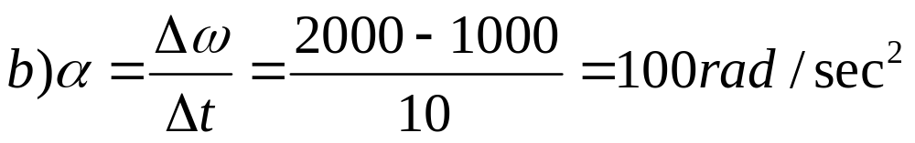
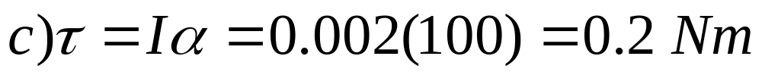
Torque, angular acceleration
A solid cylinder of mass 100.0 g and radius 0.2 m has a constant torque applied to it. This torque increases the angular velocity of the cylinder from 1000.0 rad/sec to 2000.0 rad/sec in 10.0 s. Calculate:
a) The moment of inertia of the cylinder
b) The angular acceleration of the cylinder
c) The magnitude of the torque applied
Notes:
Let’s do an example…see sheet

Slide 5
Angular momentum L
Angular momentum has the symbol L assigned to it and its SI units are kg m²/s.
Torque is the product of the magnitude of the force times the perpendicular distance of the line of action of the force to the axis of rotation.
Angular momentum is the product of the magnitude of the momentum times the perpendicular distance of the line of the velocity vector to the axis of rotation.
Notes:
Slide 5
So that’s a foce analogy between linear and rotational case. Another linear/rotational analogue we need to have a look at is momentum. We studied linear momentum in the first Mech II lecture..remember what it was ? (p=mv). Angular momentum is the rotational analogue of linear momentum. If you progress with physics you’ll come across it in quantum mechanics and orbit theory (planets and electron orbitals – big to small).
Angular momentum has the symbol L assigned to it and its SI units are kg m²/s.
Do you remember that torque was the rotational analogue of force ?
Torque is the rotational analogue to force. It is force times perpendicular distance.
Well here we have the angular or rotational analogue to momentum. We do exactly what we did with force to get it into the rotational form, that is we will multiply it by a perpendicular distance. What distance ? We use the perpendicular distance from the line of the velocity vector v to the chosen origin. What does this look like in a diagram ? First I’ll remind you of what it was for the case of force and torque.

Slide 6
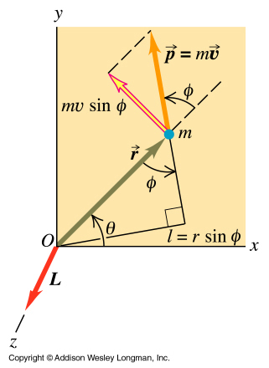
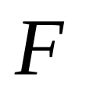
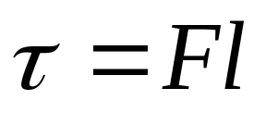
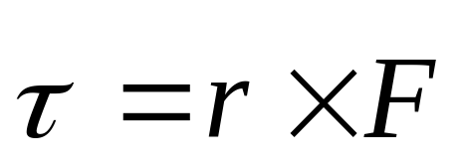
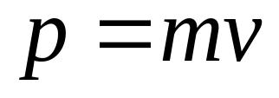
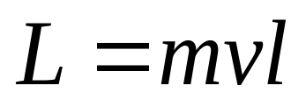
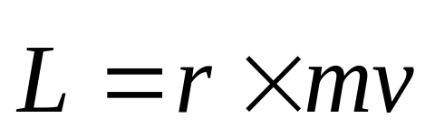
Angular momentum
Linear
Angular
Notes:
What about for angular momentum ? Well we have a momentum being combined with a distance. Just like we had for F combined with a distance to give torque. We use the perpendicular distance from the line of the velocity vector v to the chosen origin. Just as for the relationship between force and torque we used the perpendicular distance of the force’s line of action from O. This then became converted to an equation that involved a cross product of force with r, where r is the distance between the position where the force acts to the origin (O being the axis of rotation). We get the cross bit as we want the perpendicular distance. (remember that dot product is for parallel and cross for perpendicular)
For torque we had torque = F time l = r X F. So in the rotational case we have got L = mv times l where mv is the momentum, which becomes L = r cross mv.
In this diagram you can see that l is r sin psi so get angular momentum= momentum times r sin psi = mv cross r.
Don’t worry if you don’t get this…just make sure understand the next bit…

Slide 7
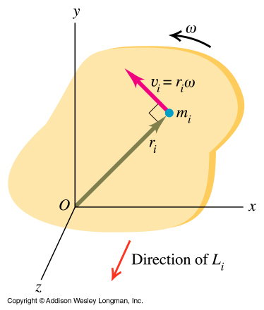
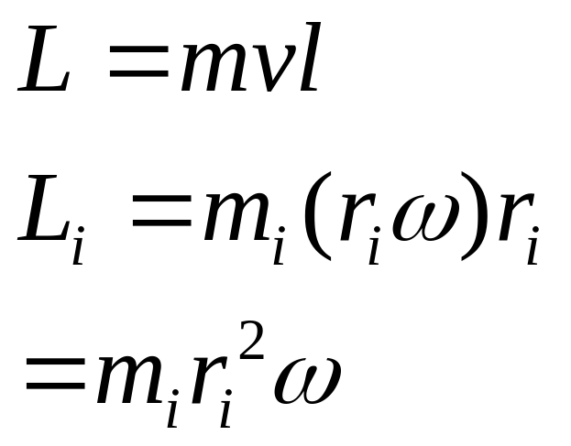
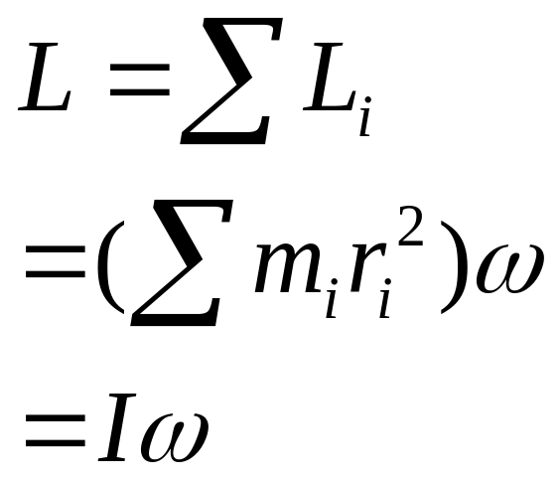
Angular momentum
Notes:
How can we make this equation into a completely rotational one
. However remember that since v=omega r it is different for different points on the body. So We start by dividing our solid rigid object into little pieces and then notice that each piece will have a mass mi and a velocity vi and a position ri from the origin or rotational axis. It’s velocity vector v is perpendicular to the position vector r as it is moving in a circle…so our l is r. So if we remember that v = omega r and that since v and r are perpendicular then the l we want is r, then this becomes, L = m omega r times r for each little piece.
If we now sum up the value of L for each piece to give us the value for the whole we get L = I omega (see equations). That’s the bit you need to know how to use.
@
Direction of Angular momentum

Slide 8
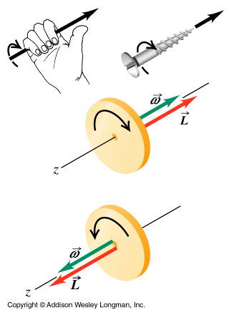
Angular momentum vector direction

Slide 9
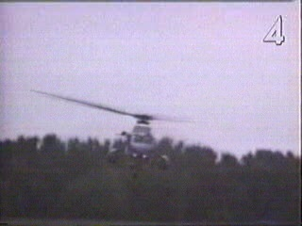
Too much angular momentum L
Notes:
Too much angular momentum.

Slide 10
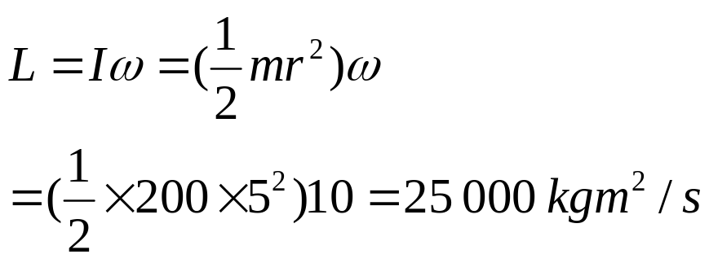
Example: Angular momentum - disk
A large disk is rotating at 10 rad/s about an axis through its centre. The disk has a mass of 200.0 kg and a radius of 5.0 m. Calculate the magnitude of its angular momentum.

Slide 11
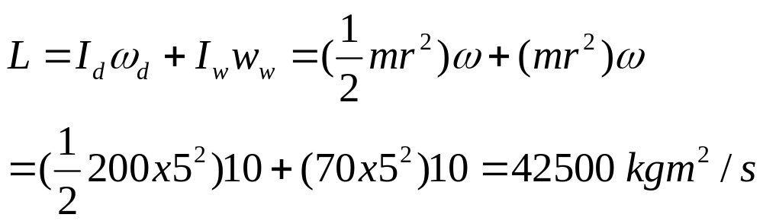
Angular momentum
If a woman of mass 70 kg now stands on the rim of this disk, what is the total angular momentum of the woman plus disk system (treat the woman as a particle).

Slide 12
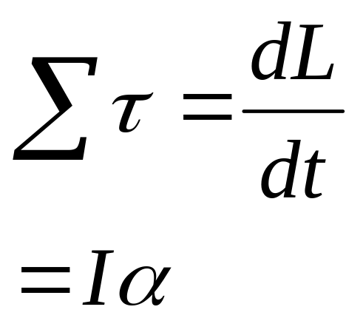
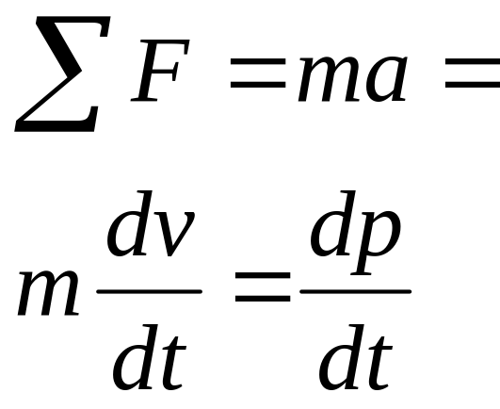
Angular momentum
Linear case
Angular case
Notes:
We have another analogy between the linear and angular case. In linear mechanics you may remember that force = rate of change of momentum = dp/dt
Get from force = ma = mdv/dt. Define p as mv and get F=d/dt(mv) = dp/dt
What is it for the angular case ? Replace F with torque and p with L and you get the net torque = dL/dt. Can see from L=I omega that dL/dt = I alpha (as d/dt omega(or angular speed) = accn). The rate of change of angular momentum of a particle equals the net torque acting on it. Just like the rate of change of linear momentum = net force acting.
This is exactly the same conclusion that we came to using the Newton’s second law analogy, F = ma

Slide 13
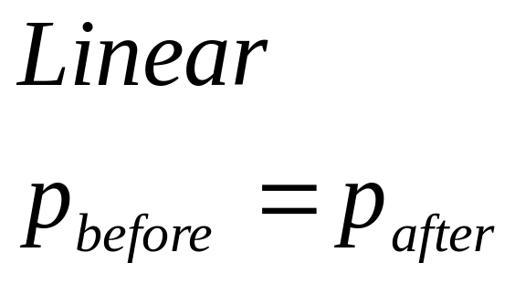
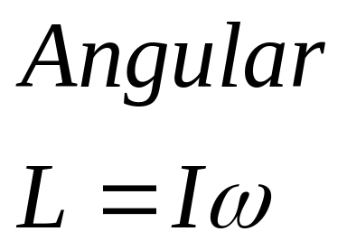
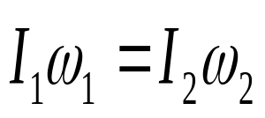
Conservation of Angular momentum L
Just as linear momentum p is conserved in collisions. Angular momentum L is also conserved.
Hence
Notes:
The last analogy I want to cover is that of conservation of momentum.
In the linear case we have the case that if the sum of the external forces = 0 then the rate of change of momentum = zero and hence momentum is conserved. Momentum before the interaction = momentum after.
For the rotational case you Can also see that if the net external torque acting on the system is zero, the total angular momentum of the system is constant (conserved). DL/dt is zero ie not changing.
This means that in this situation initial angular momentum = final angular momentum, I1omega 1 = I2 omega2.
Lets do two examples.

Slide 14
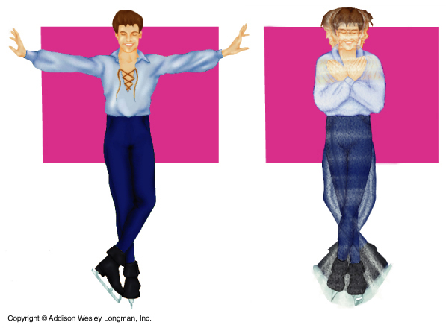
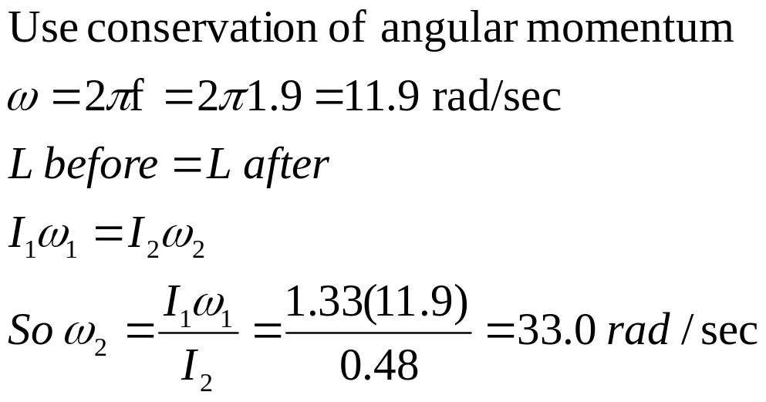
Conservation of Angular momentum
An ice skater spins with arms outstretched at 1.9 rev/s. His moment of inertia at this time is 1.33 kgm². He pulls in his arms to increase his rate of spin. If his moment of inertia is 0.48 kgm² after he pulls in his arms, what is his new rate of rotation ?
Notes:
Why is I smaller when arms pulled in ?…….R is smaller.

Slide 15
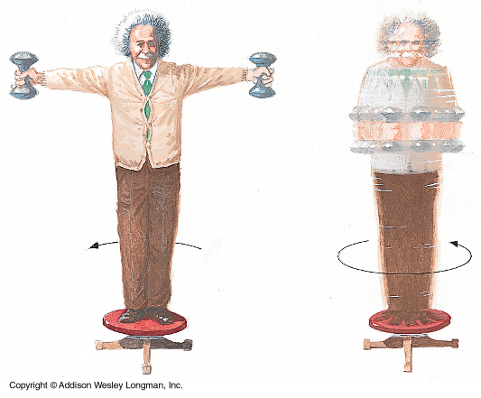
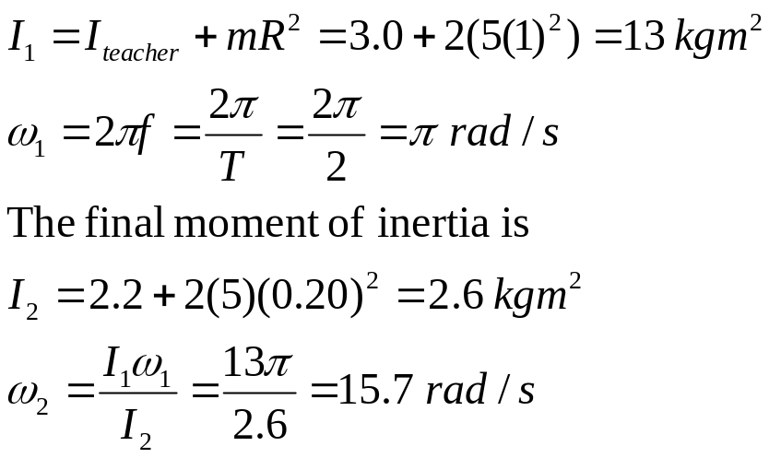
10.11 Anyone can be a ballerina
A teacher stands at the centre of a turntable holding his arms extended horizontally with a 5.0 kg dumbbell in each hand. If he is initially spinning one revolution in 2.0 sec, find the teachers final angular velocity if he brings his hands in.
I of teacher = 3.0 kgm² with arms outstretched. I=2.2 kgm² with arms in.
The dumbbells are 1.0 m from the axis when arms outstretched and 0.2 m with hands in.

Slide 16
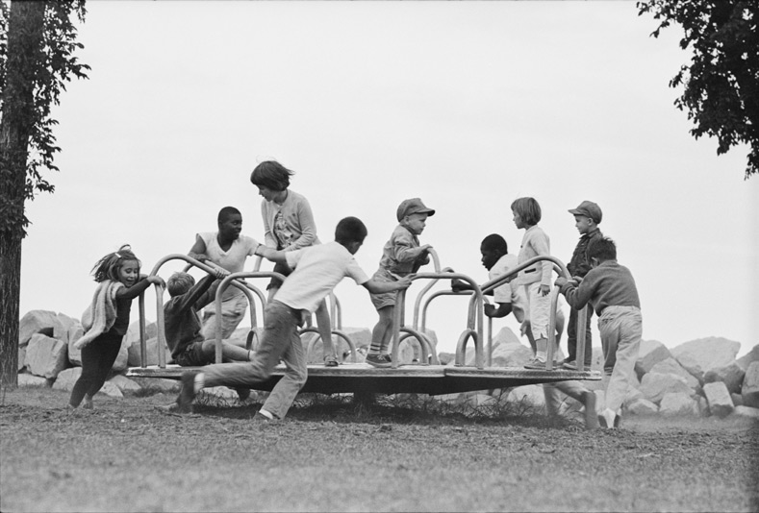
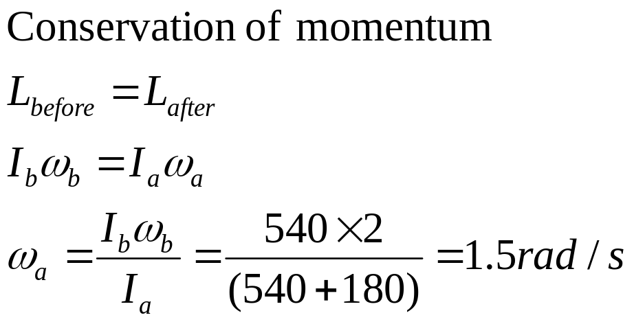
Example: conservation of angular momentum.
A merry-go-round with children with moment of inertia I= 540 kgm² is rotating with an angular velocity of 2 rad/sec. Another 3 children jump on the outside with no angular velocity and a moment of inertia of I = 180 kgm² . Find the final angular velocity of the merry-go-round.

Slide 17
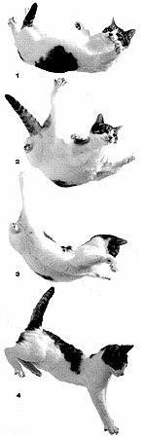
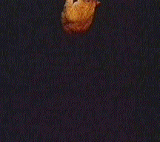
Cat Physics- How does a cat always land on its feet?
Cat landing on feet
  Cats turn using a combination of 3 methods
    Rotating shoulders different direction to pelvis
    Shaping their body like a V.
    Bringing from legs in in to reduce moment of inertia
Notes:
How does a cat always land on its feet ..?
You know how toast always falls buttered side downwards.
Well a cat will land on its feet even if you tape buttered toast to their back…..
What is the minimum height that a cat will land on its feet. Cats can right themselves in 0.3 seconds. How can we find what height this corresponds to?.......0.46 cm…
Why do we walk swinging arms…?

Slide 18
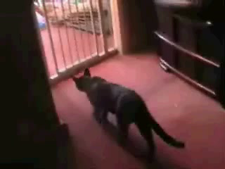

Slide 19

Helicopter- What stops the helicopter spinning when it is forcing the main blades around?

Slide 20
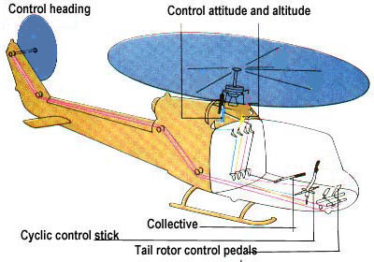
Controls of helicopter-tail rotor stops helicopter spinning. How does it move forward?

Slide 21
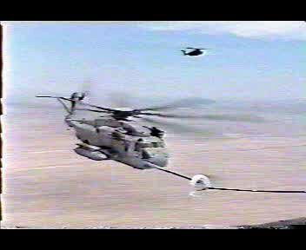

Slide 22
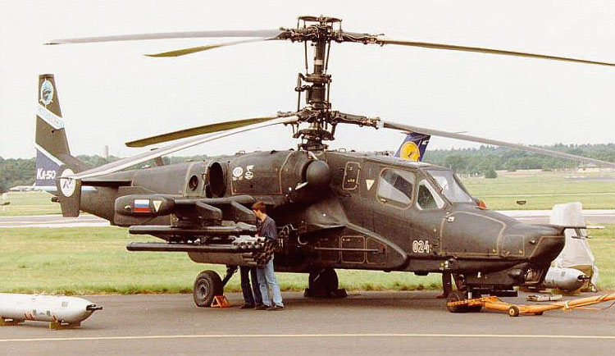
One solution to the rotating helicopter- note no tail rotor
Contra-rotating coaxial Kamov 50
Notes:
Coaxial cable

Slide 23
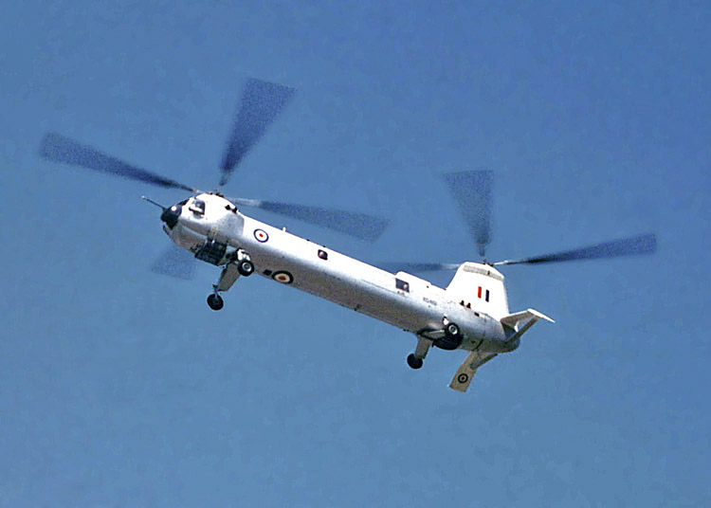
Twin Propeller Belvedere
Should the blades spin the same way or opposite way to neutralise angular momentum?

Slide 24
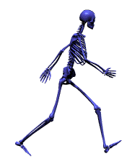
Walking swing arms
Why do you swing your arms when walking, or running?

Slide 25
